Slide 1

Agile Software Development
Module Number: 5
Model Diagrams

Slide 2
Agile Software Development
        Syllabus
Working with Diagrams: Model Diagram,
Making Effective Use of UML, Iterative Refinement,
Draw FSM Diagrams, State Diagrams: The Basics Using FSM.

Slide 3
Agile Software Development
        AIM:
The aim of this module is to understand the concepts of model diagrams.

Slide 4
Agile Software Development
        Objectives:
The Objectives of this Module is to:
Understand the concepts of Model diagram in software design
Demonstrate the structure of Finite State Diagram.

Slide 5
Agile Software Development
        Outcomes:
At the end of this Module, Students will be able to:
Define model diagram and FSM.
Describe about benefits of UML.

Slide 6
Agile Software Development
        Why model?
Why do engineers build model?
Why do structural engineers build models of bridges?
What purposes do these models serve?
Answer for all these questions,
  To find out whether their idea/plan/design works or not.
  Saving Money.
  Life time.
  Quantity/Quality focused.

Slide 7
Agile Software Development
        Why Build Models of Software?
Web Page
Web Portal
Desktop Application
Mobile App
System Software
Comprehensive Design before Coding.
One can prepare blueprint but dozen needs to build it.

Slide 8
Agile Software Development
        Making Effective Use of UML
Use Case Diagram
Class Diagram
Sequence Diagram
Collaboration Diagram
State Diagram
Diagrams are most useful for communicating with others and for helping you work out design problems.
UML is enormously convenient for communicating design concepts among software developers.

Slide 9
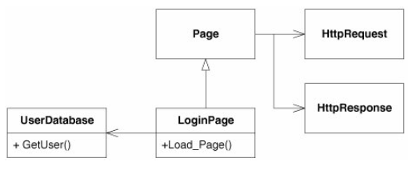
Agile Software Development
        Making Effective Use of UML - Communicating with others
UML is enormously convenient for communicating design concepts among software developers.
A lot can be done with a small group of developers at a whiteboard
UML is very good for communicating focused design ideas.

Slide 10
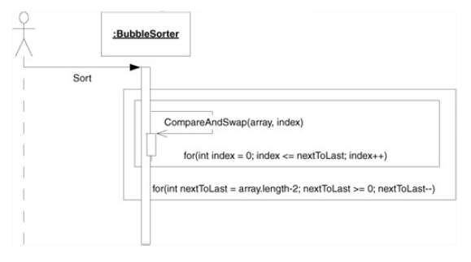
Agile Software Development
        Making Effective Use of UML - Road Maps
UML can be useful for creating road maps of large software structures.
Road maps give developers a quick way to find out which classes depend on which others

Slide 11
Agile Software Development
        Making Effective Use of UML - Back-End Documentation
The best time to create a design document that you intend to save is at the end of the project.
Such a document will accurately reflect the state of the design as the team left it and could certainly be useful to an incoming team.

Slide 12
Agile Software Development
        Making Effective Use of UML - What to Keep and What to Throw Away
Creating them on a persistent medium.
Because most of our UML should be short-lived.
Some diagrams, however, are useful to save.
Save the diagrams that record complex protocols that are difficult to see in the code.

Slide 13
Agile Software Development
        Iterative Refinement
The process of refinement is used to get the better result.
In UML diagrams, can I draw first state diagram? Or Sequence diagram?
Because I know well.
But, we need to start with Class Diagrams

Slide 14
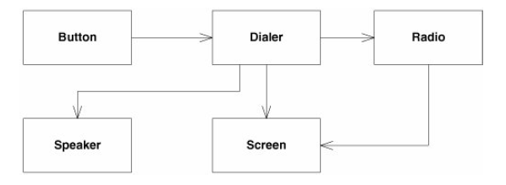
Agile Software Development
        Iterative Refinement – Class Diagram

Slide 15
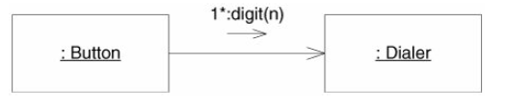
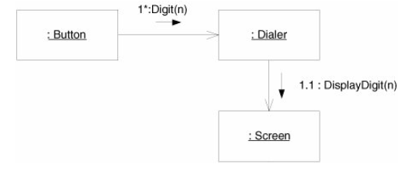
Agile Software Development
        Iterative Refinement – Sequence Diagram

Slide 16

Agile Software Development
        Iterative Refinement – why we need?

Slide 17
Agile Software Development
        State Diagrams
UML has a rich set of notations for describing finite state machines (FSMs).
FSMs are an enormously useful tool for writing all kinds of software.

Slide 18
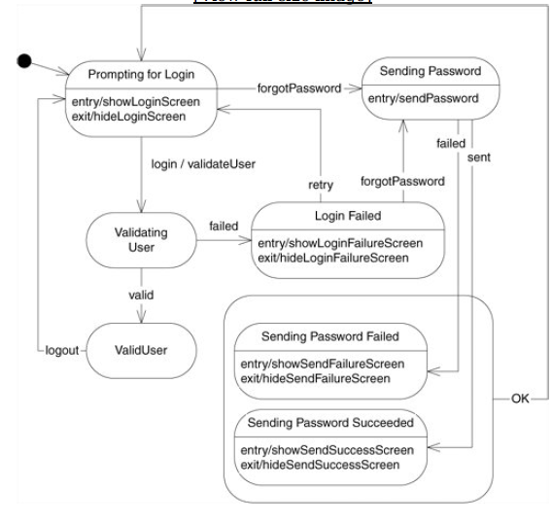
Agile Software Development
        Basic State Diagram

Slide 19
Agile Software Development
        Basic of State Diagrams – Initial Pseudo-State
Black Dot Circle is initial pseudo-state.
An FSM begins its life following the transition out of this pseudo-state.

Slide 20
Agile Software Development
        Basic of State Diagrams – Special Events
The lower compartment of a state contains event/action pairs.
If one of these special events occurs while the FSM is in that state, then the corresponding action is invoked.
Example Login OTP, Fingerprint

Slide 21
Agile Software Development
        Basic of State Diagrams – Super-state
We can draw a super-state around those similar states and simply draw the transition arrows leaving the super-state instead of leaving the individual states.

Slide 22
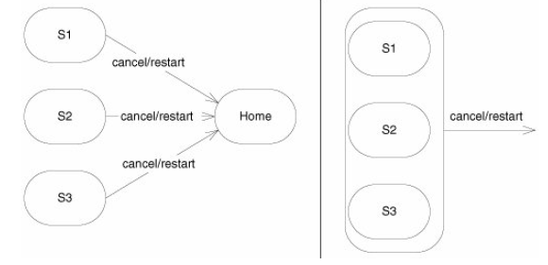
Agile Software Development
        Basic of State Diagrams – Super-state

Slide 23
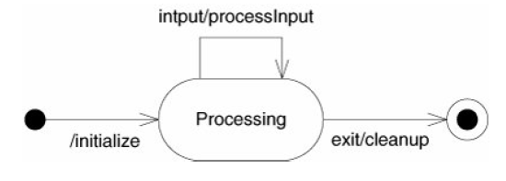
Agile Software Development
        Basic of State Diagrams – Final Pseudo-state

Slide 24
Agile Software Development
        Basic of State Diagrams – Final Pseudo-state
Any action on the transition into the final pseudo-state will be the last action invoked by the FSM.
Dot with Rounded Circle denotes the final pseudo-state.

Slide 25
Agile Software Development
        Using FSM
Finite state machines are a powerful concept for structuring software.
UML provides a very powerful notation for visualizing FSMs

Slide 26
Agile Software Development
        FSM Advantages
Finite state machines are flexible
Easy to move from a significant abstract to a code execution
Low processor overhead
Easy determination of reachability of a state

Slide 27
Agile Software Development
        FSM Application Areas
FSMs are used in games
The finite state machines are applicable in vending machines.
Further, video games, traffic lights, controllers in CPU, text parsing, analysis of protocol, recognition of speech, language processing

Slide 28
Self Assessment Questions & Assignment - 5

Slide 29
Agile Software Development
        Self Assessment Question
1. ‘FAT’ Interfaces are dealt by,
      Interface Segregation
      Interface Defining
      Interface Explanation
      Interface Deriving
      Answer: A. Interface Segregation

Slide 30
Agile Software Development
        Self Assessment Question
2. Mandatory Class diagram parts are,
      Class name, attributes
      Attributes, Functions
      Class name, Functions
      Attributes, Objects
      Answer: C. Class name, Functions

Slide 31
Agile Software Development
        Self Assessment Question
3. Which diagram in UML shows a complete or partial view of the structure of a modeled system at a specific time?
      Class Diagram
      Object Diagram
      Sequence Diagram
      State Diagram
      Answer: D. State Diagram

Slide 32
Agile Software Development
        Self Assessment Question
4. Which of the following diagram is time oriented?
      Sequence Diagram
      Class Diagram
      State Diagram
      Sequence Diagram
      Answer: A. Sequence Diagram

Slide 33
Agile Software Development
        Self Assessment Question
5. Which diagram is used to show interactions between messages are classified as?
      Object Diagram
      Collaboration Diagram
      Class Diagram
      Sequence Diagram
      Answer: B. Collaboration Diagram

Slide 34
Assignment - 4

Slide 35
Consider your Assignment-1,
(1) Draw the Class diagram for any one module
(2) For the same module draw the Sequence diagram
(3) For any single operation draw the State Diagram

Slide 36
Agile Software Development
        Document Link
Topic | URL | Notes
Times New Roman-14PT | https://www.scaledagileframework.com/refactoring/ | Times New Roman-14PT
Times New Roman-14PT | Times New Roman-14PT | Times New Roman-14PT
Times New Roman-14PT | Times New Roman-14PT | Times New Roman-14PT

Slide 37
Agile Software Development
        Video Link
Topic | URL | Notes
Times New Roman-14PT | Times New Roman-14PT | Times New Roman-14PT
Times New Roman-14PT | Times New Roman-14PT | Times New Roman-14PT
Times New Roman-14PT | Times New Roman-14PT | Times New Roman-14PT

Slide 38
Agile Software Development
        E- Book Link
Ebook name | Chapter | Page No. | Notes | URL
Times New Roman-14PT | Times New Roman-14PT | Times New Roman-14PT | Times New Roman-14PT | Times New Roman-14PT
Times New Roman-14PT | Times New Roman-14PT | Times New Roman-14PT | Times New Roman-14PT | Times New Roman-14PT

Slide 39
Thank you ALL!

